Slide 1
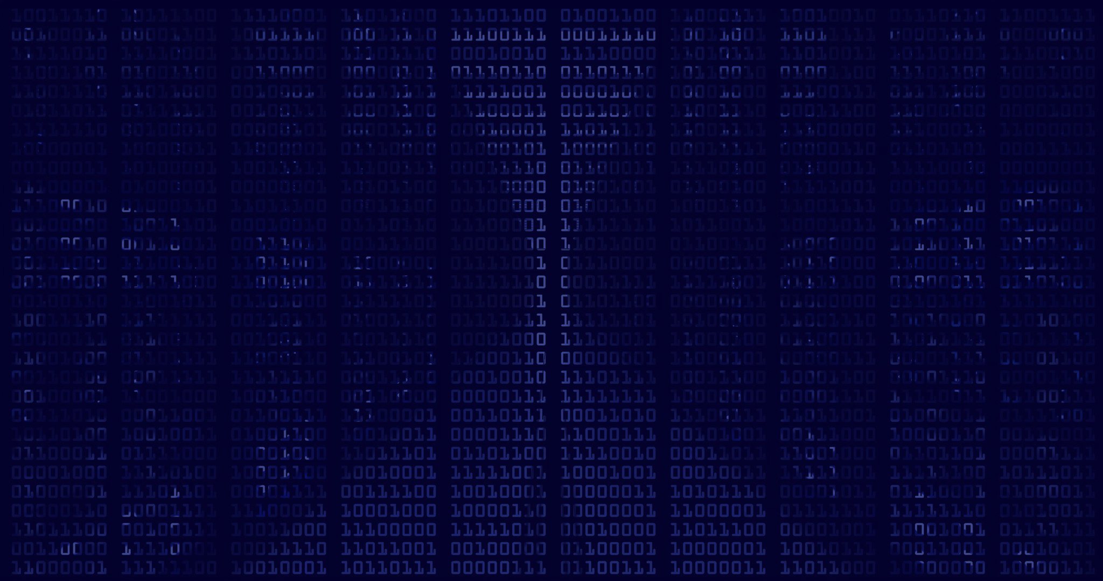


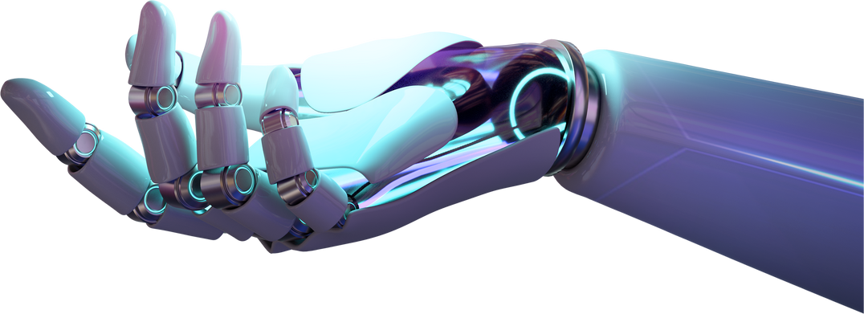
DEEP LEARNING AND NEURAL NETWORKS
DEEP LEARNING FOR ROAD SAFETY: POTHOLE DETECTION
Group 4:
Omkar Bhalerao MBA/BA02/005
Debashis Boruah MBA/BA02/007
Deepak Ranjan Nayak MBA/BA02/008
Nitesh Chandra MBA/BA02/014
Rounak Mondal MBA/BA02/019
Suraj Kumar MBA/BA02/022

Slide 2
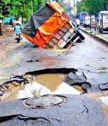
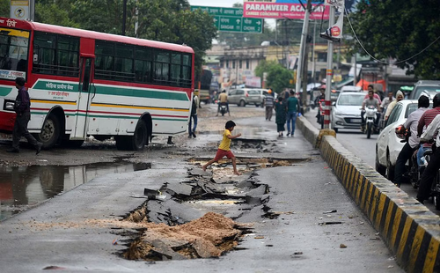
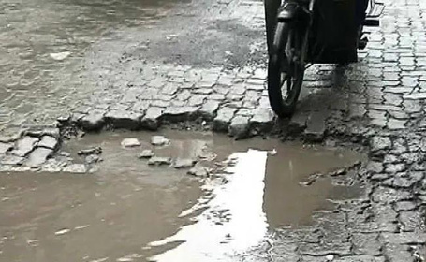
Problem Statement
The objective of this project is to develop a robust pothole detection system leveraging Artificial Neural Networks (ANN) and Convolutional Neural Networks (CNN) and Inception V3.

Slide 3



STEP 1
Dataset Acquiring
STEP 2
FLOW OF THE PROJECT
Preprocessing the data
STEP 3
Training Deep learning model
STEP 4
Evaluating and Interpreting the model results

Slide 4
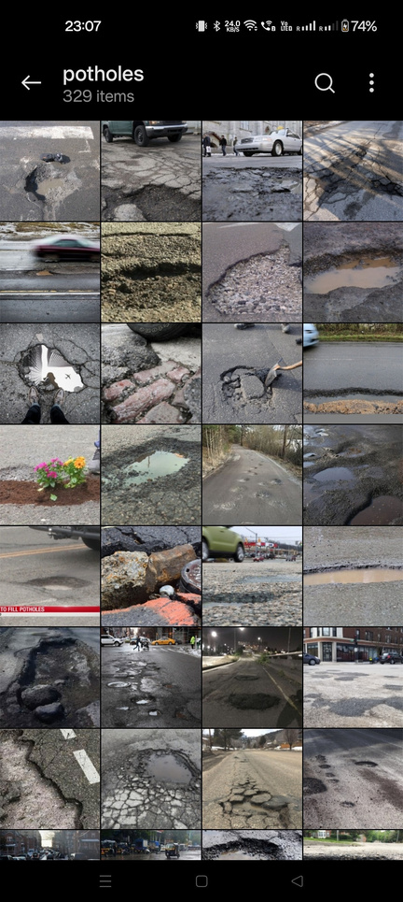
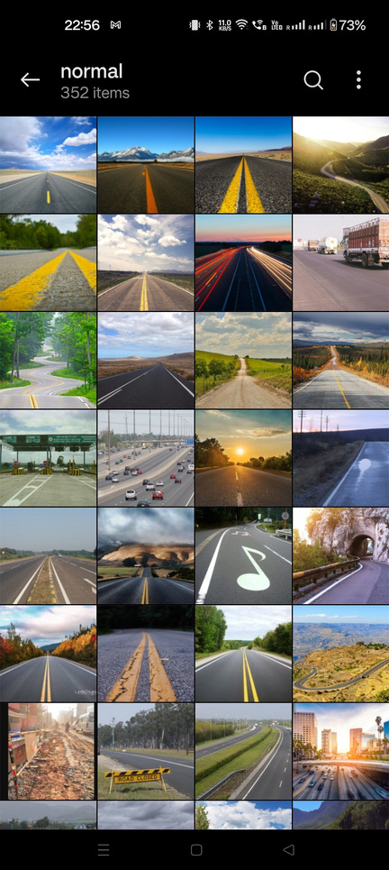
DATASET EXPLORATION AND ANALYSIS
Our project utilizes a dataset specifically curated for the task of pothole detection. This dataset (from Kaggle) comprises images of roads, some with potholes and others without.
The dataset is neatly categorized into two classes:
‘Normal’: This category includes 352 images of smooth, pothole-free roads.
‘Potholes’: This category contains 329 images of roads with visible potholes.
In total, our dataset consists of 681 images, providing a substantial amount of data for our model to learn from.
As part of preprocessing, all images in the dataset were resized to a consistent size of 196x196 pixels.

Slide 5
Models used
ANN
CNN
INCEPTION V3
• Suitable for structured data and capable of learning complex relationships.
• Initial exploration for pothole detection.
• CNNs excel at learning hierarchical features from images.
• Convolutional layers detect patterns regardless of their position.
• InceptionV3 is pre-trained on ImageNet, offering powerful feature extraction.
• Transfer learning enhances model performance with less data.

Slide 6
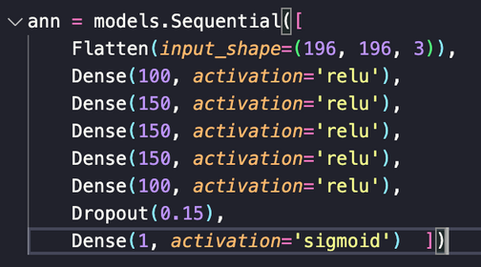
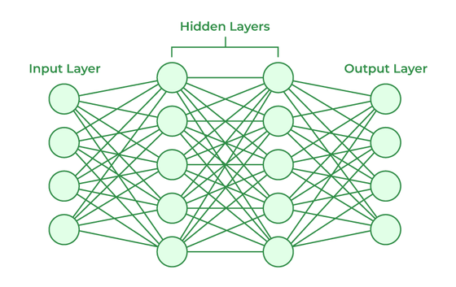
ANN
Architecture
1. Input Layer:
Shape: (196, 196, 3)
Represents the dimensions of the input images (196x196 pixels with 3 color channels).
2. Flatten Layer: Converts the multi-dimensional input into a one-d array.
3. Dense Layers with ReLU Activation:
5 Layer : 100 neurons with ReLU activation.
These layers perform feature extraction through non-linear transformations.
4. Dropout Layer: Reduces overfitting by randomly setting a fraction of input units to zero during training.
Dropout Rate: 0.15 (15% of neurons are randomly dropped).
5. Output Layer:
Dense layer with Sigmoid activation.

Slide 7
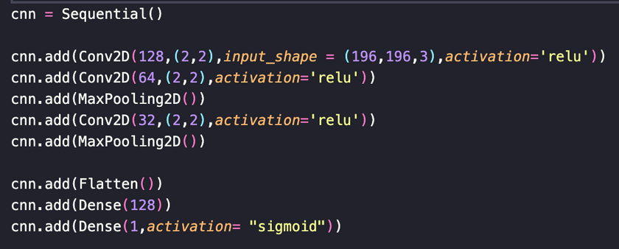
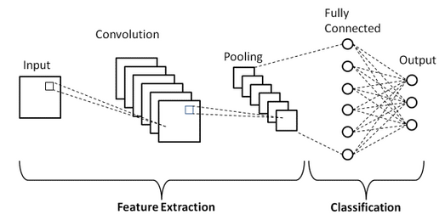
CNN
Architecture
1. Input Layer:
Shape: (196, 196, 3)
2. Convolutional Layers with ReLU Activation:
Layer 1: Conv2D with 128 filters, kernel size (2, 2), and ReLU activation.
Layer 2: Conv2D with 64 filters, kernel size (2, 2), and ReLU activation.
Layer 3: MaxPooling2D layer for spatial down-sampling.
Layer 4: Conv2D with 32 filters, kernel size (2, 2), and ReLU activation.
Layer 5: MaxPooling2D layer for spatial down-sampling.
3. Flatten Layer
4. Dense Layers with ReLU Activation:
Layer 6: Dense layer with 128 neurons and ReLU activation.
5. Output Layer:
Dense layer with Sigmoid activation.

Slide 8
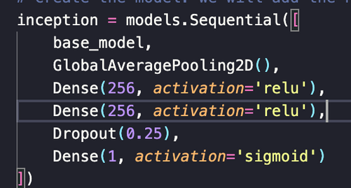
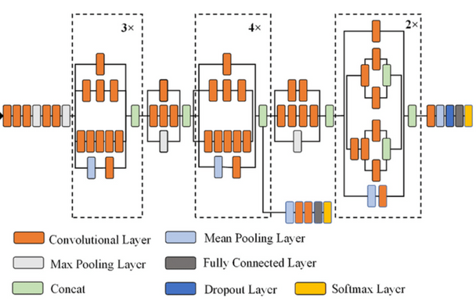
Inception V3
Architecture
1. Base Model: InceptionV3
Pre-trained on ImageNet for general feature extraction.
Includes complex inception modules for efficient feature learning.
2. Global Average Pooling 2D Layer:
Reduces the spatial dimensions of the input.
Extracts information from the features obtained from the base model.
3. Dense Layers with ReLU Activation:
Layer 1: Dense layer with 256 neurons and ReLU activation.
Layer 2: Dense layer with 256 neurons and ReLU activation.
4. Dropout Layer:
Purpose: Mitigates overfitting by randomly dropping 25% of neurons during training.
5. Output Layer:
Dense layer with Sigmoid activation.

Slide 9


~92%
ACCURACY WITH CNN

Slide 10
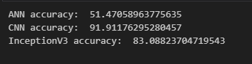
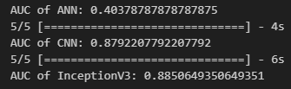
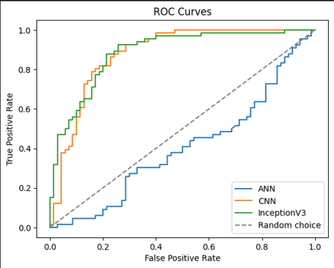
Model Result and Interpretion
The results can be interpreted as follows:
AUC of ANN: 0.404: The ANN model has an AUC of about 0.404. This is relatively low, suggesting that the ANN model may not be performing well on this task.
AUC of CNN: 0.879: The CNN model has an AUC of about 0.879. This is a high AUC, suggesting that the CNN model is performing well on this task.
AUC of InceptionV3: 0.885: The InceptionV3 model has an AUC of about 0.885. This is a fairly high AUC, suggesting that the InceptionV3 model is performing better than all the above models in this task of detection. The closer the AUC to 1, the better the model is at distinguishing between positive and negative classes.

Slide 11
THANK YOU
GROUP : 4

